Slide 1


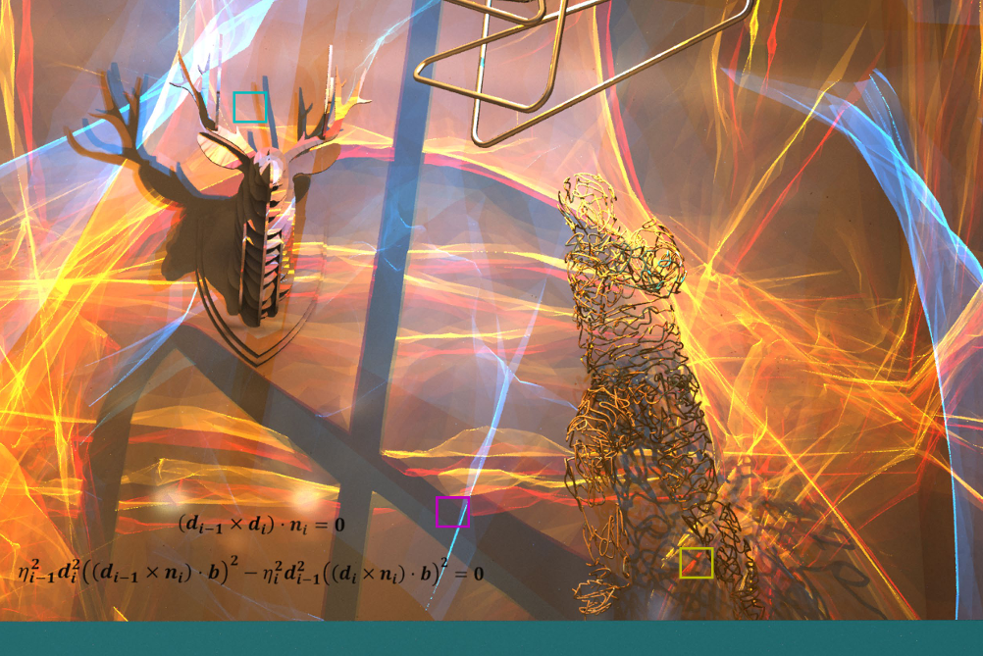
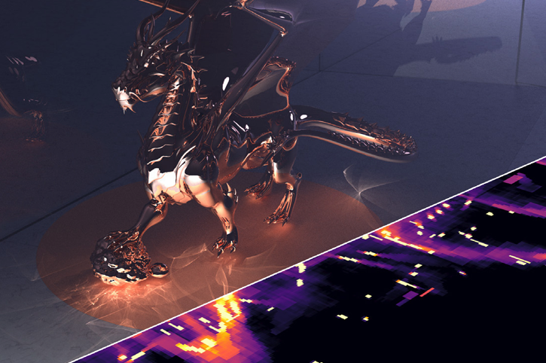
Light Transport with Specular Constraints Modeling, Solving, and Bounding
Homepage
Zhimin Fan Advisor: Jie Guo
zhiminfan2002@gmail.com
Nanjing University
August 21, 2025

Slide 2

Specular light transport is important
Caustics, a typical effect caused by specular paths

Slide 3
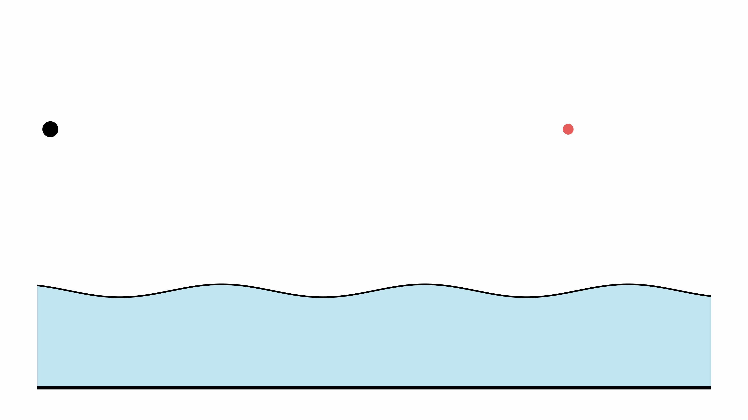
Path tracing
[Kajiya 1986]
Camera
Light source
Hard to connect to the light source

Slide 4
Path tracing
[Kajiya 1986]
Camera
Light source
Incident radiance: near-delta distributions

Slide 5
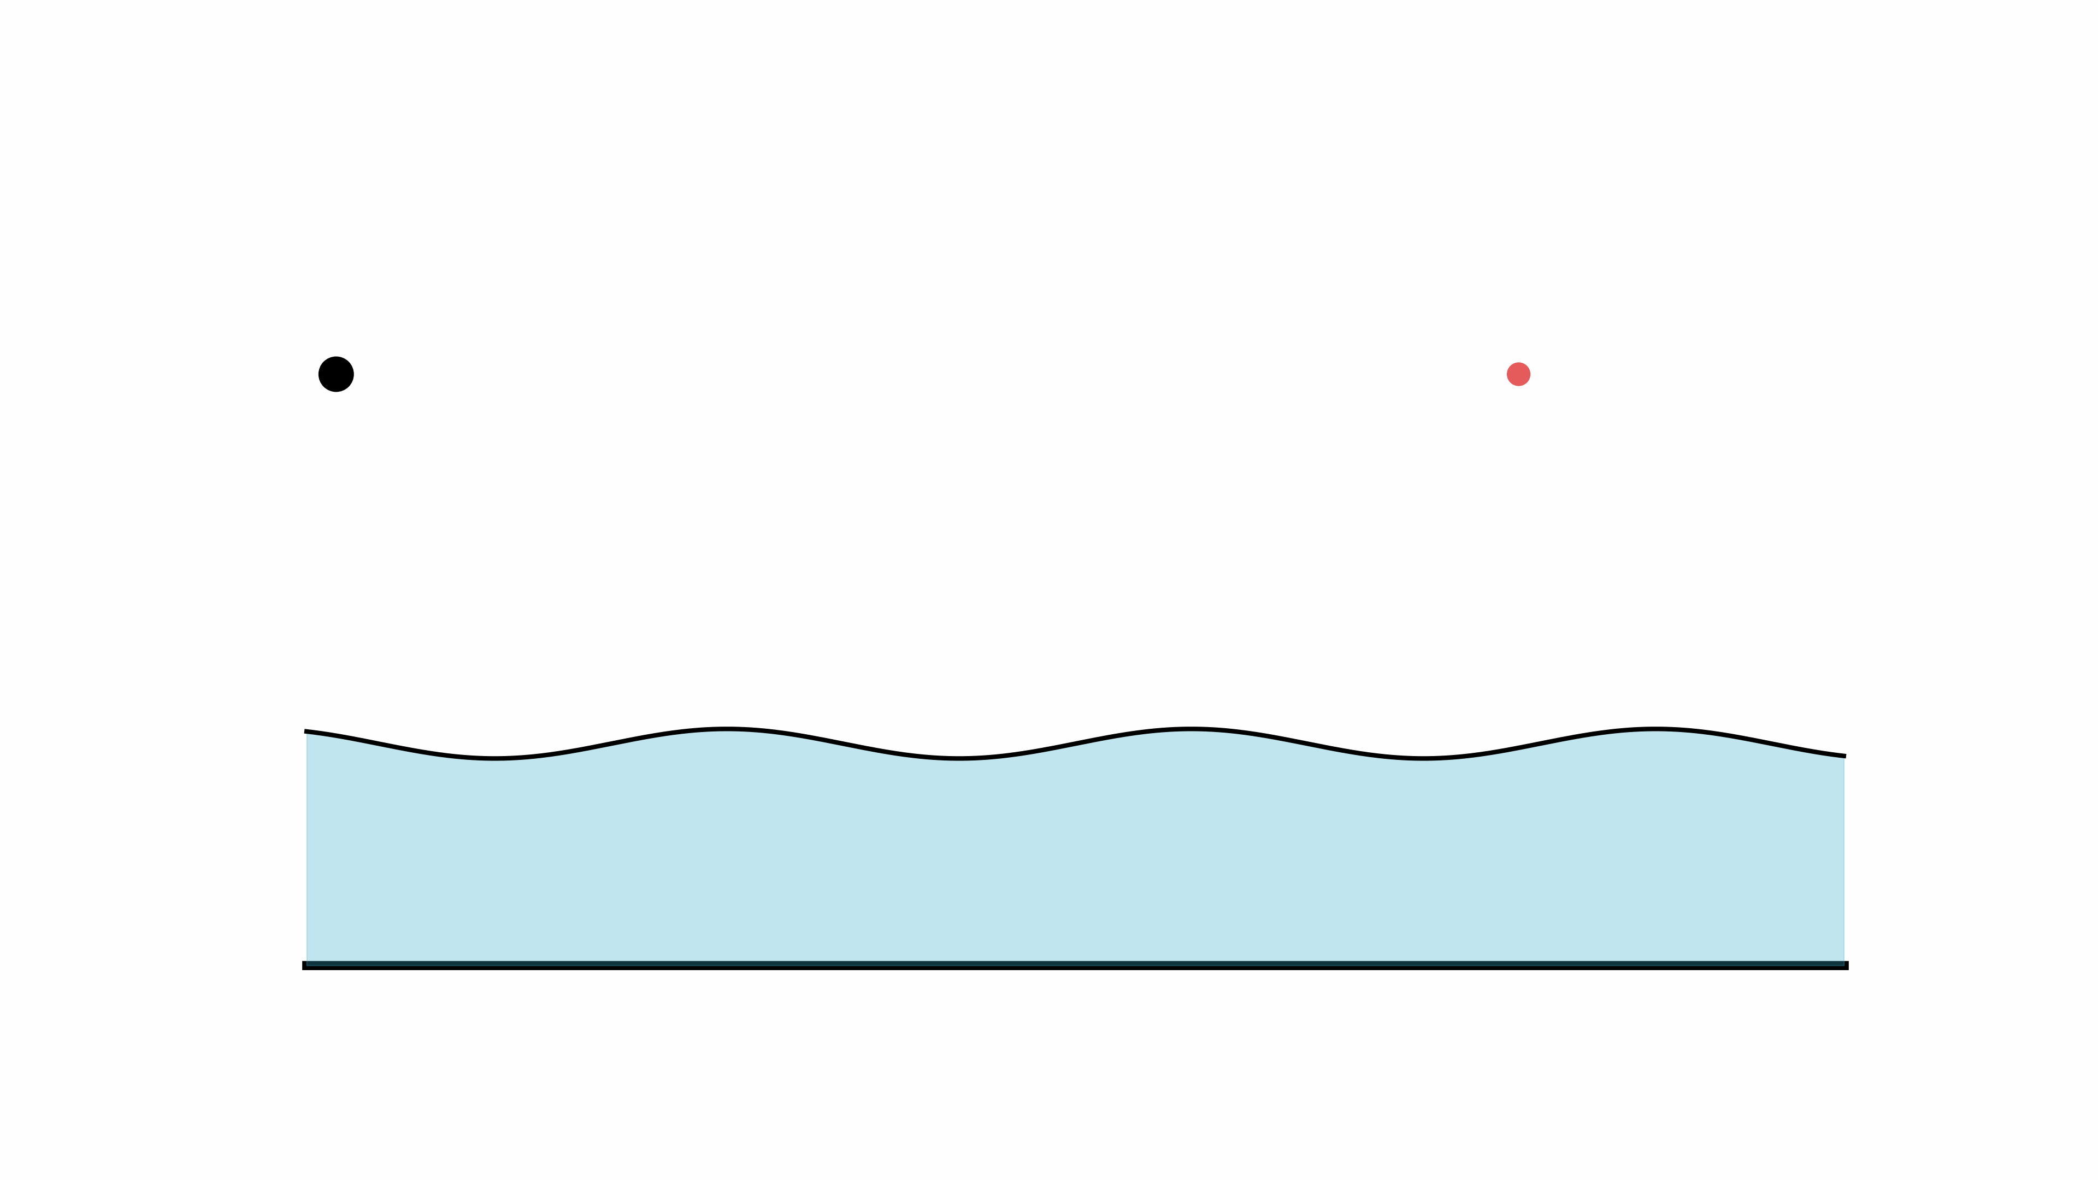
Photon mapping
[Jensen 1996]
Bias due to spatial relaxation

Slide 6
Rendering sharp caustics is difficult!
Path guiding [Müller et al. 2017]
SPPM [Hachisuka et al. 2009]
Blurring and noise
Extremely slow to converge

Slide 7








Specular path
Local sampling fails to reach a (near-)point light source
Specialized methods connect endpoints with specular vertices
Problem: How to connect?
$$x_{L}$$
Miss!
$$x_{3}^{∗′}$$
$$x_{2}^{∗}$$
$$x_{2}^{∗′}$$
$$x_{1}^{∗}$$
$$x_{1}^{∗′}$$
Diffuse
$$x_{D}$$

Slide 8
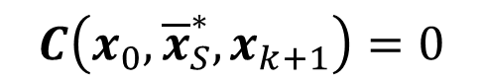
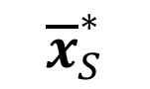
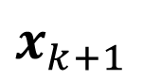
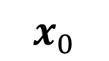
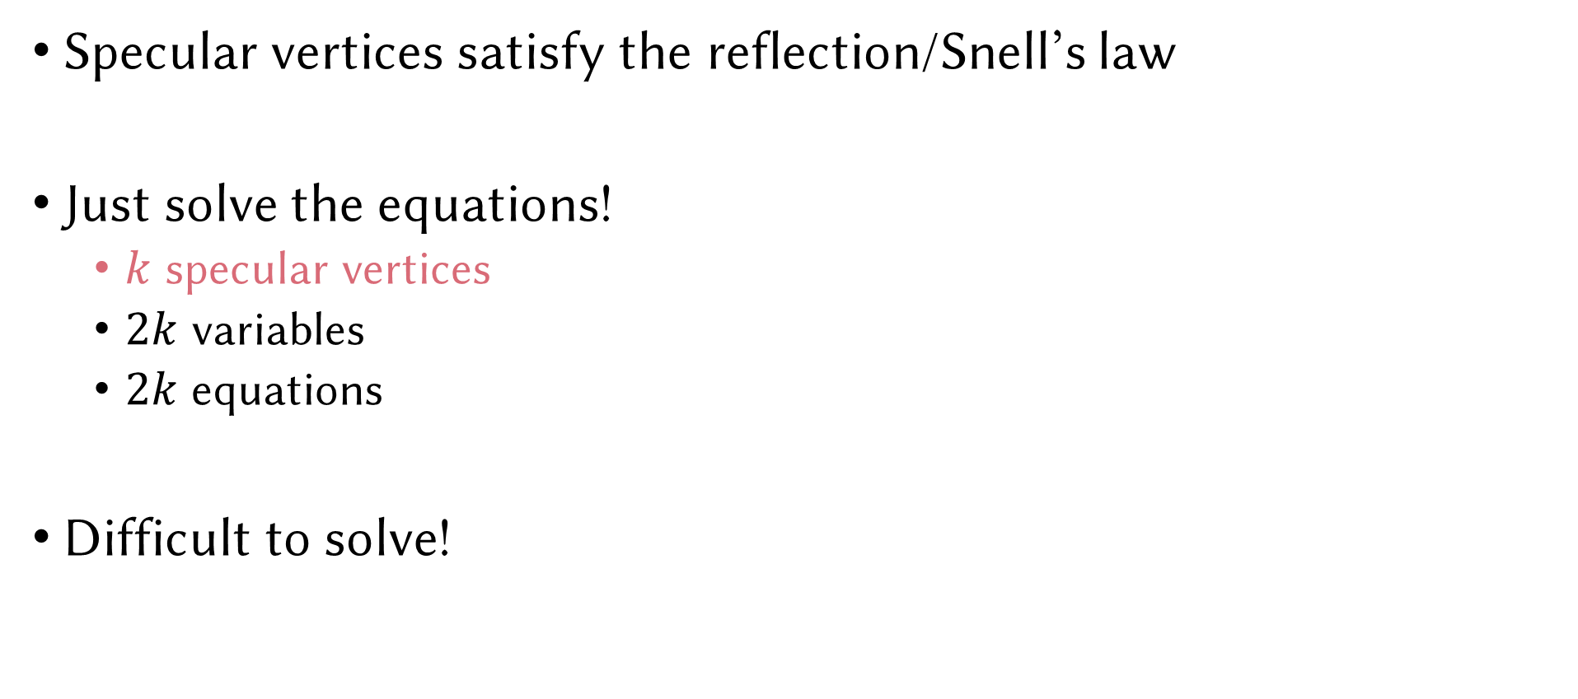
Specular constraints
$$x_{k+1}$$
Specular vertices satisfy the reflection/Snell’s law
Just solve the equations!
$k$ specular vertices
$2k$ variables
$2k$ equations
Difficult to solve!
$${\overline{x}}_{S}^{∗}$$
$$C\left(x_{0},{\overline{x}}_{S}^{∗},x_{k+1}\right)=0$$
$$x_{0}$$
Notes:
Admissible specular chains satisfy the reflection/Snell’s law, called specular constraints.
So just Solve equations.
The variables are the coordinates of specular vertices.
The constraints are the reflection law or Snell’s law.
Unfortunately, solving these equations are difficult.

Slide 9
Recent advancements
Point sampling
Manifold Sampling [Zeltner20]
Manifold Path Guiding [Fan23]
Region analysis
Path Cuts [Wang20]
Specular Polynomials [Fan24]
Bernstein Bounds [Fan25]
Manifold NEE [Hanika15]
Manifold Exploration [Jakob12]
Spindle Test [Walter09]
Other works
Analytic GGX integral [Loubet20], Path-cut-based guiding [Li22]
Large jump for manifold sampling [Jhang22], Specular path reuse [Xu23], Neural manifold sampling [Yu23]
Photon-guided sampling [Lee24], Single-bounce dimension reduction [Granizo-Hidalgo24], Position-normal manifold clustering [Wu25]

Slide 10
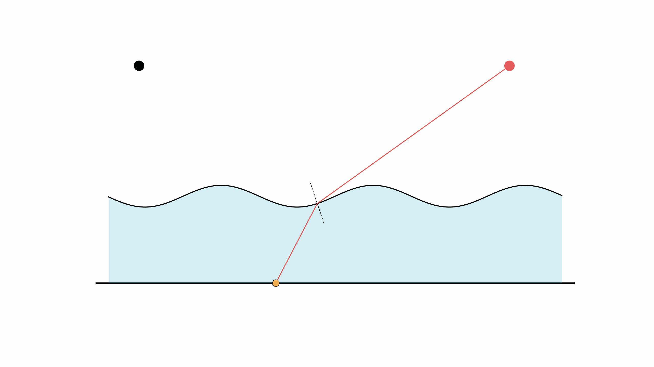
Manifold: deterministic init.
Manifold next event estimation [Hanika et al. 2015]

Slide 11
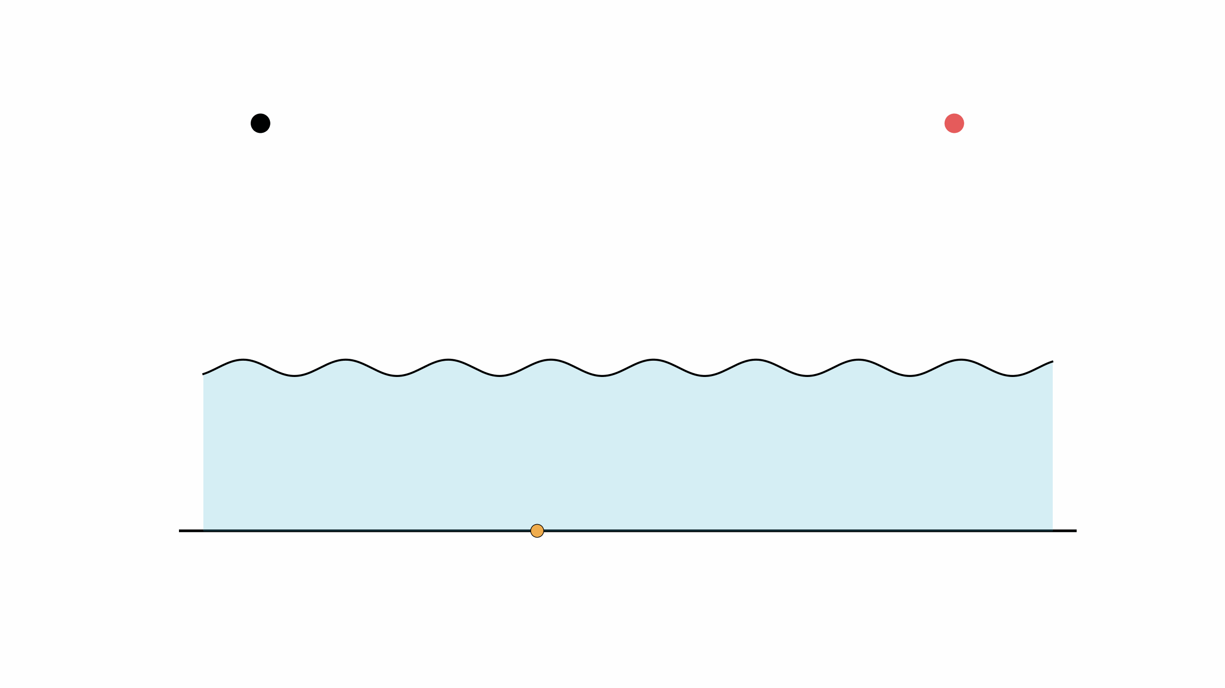
Manifold: uniform stochastic sampling
Specular manifold sampling [Zeltner et al. 2020]

Slide 12
Manifold path guiding: motivation
MNEE finds at most one solution, resulting in energy loss
SMS uniformly samples the seeds, which leads to high variance
Goal: find paths that are not only admissible but also “important”
MNEE
SMS
Ours
solution
seed chain
diverged
Notes:
MNEE, which heuristically generates seed paths, only finds at most one solution, therefore resulting in energy loss. SMS, which uniformly samples seeds, introduces high variance. Like a path tracer which uniformly samples everything, it generates noisy images. Therefore, our goal here is to find specular paths that are not only admissible but also important.

Slide 13
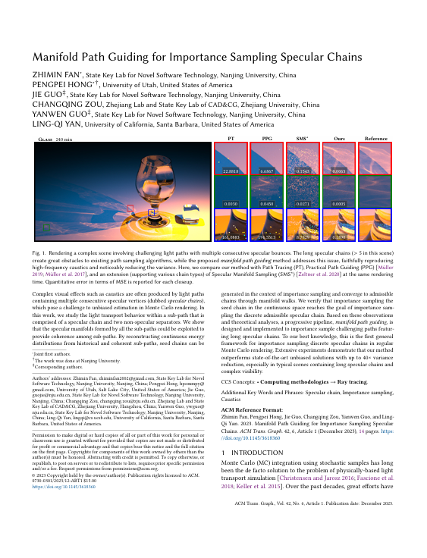
Fitting
Data-driven Modeling

Slide 14

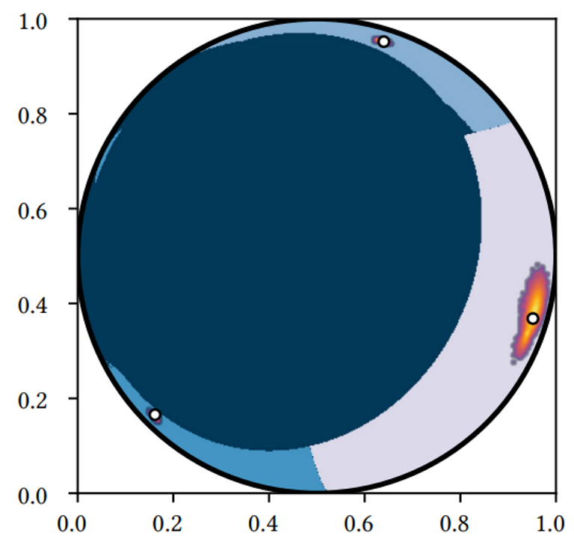
Manifold: importance sampling
Manifold path guiding [Fan et al. 2023]

Slide 15
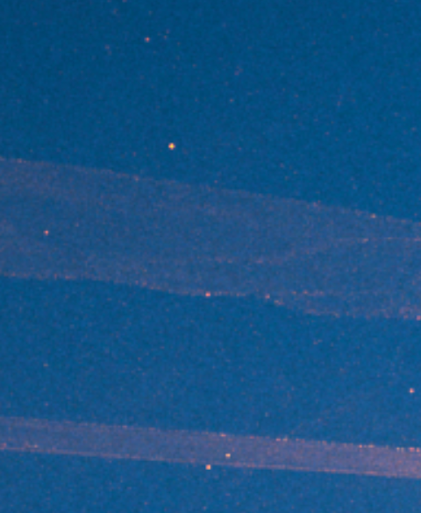
Results (4 hours)
Unbounded variance / Newton solver’s local convergence
Notes:
missing most of the interesting caustic patterns.

Slide 16
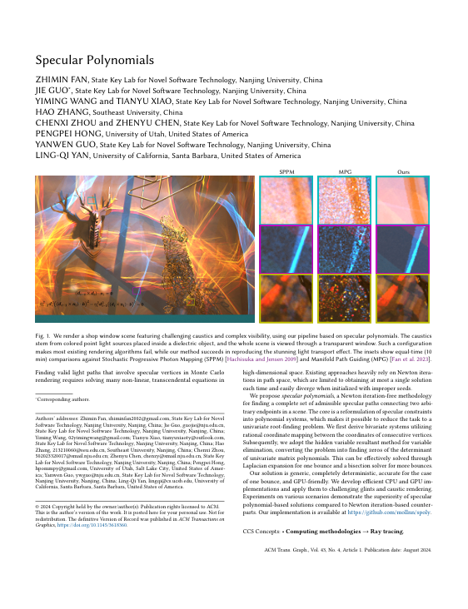
Solving
Analytic Modeling

Slide 17
Why Polynomials?
Root-solving with global convergence
Root isolation by computing derivatives recursively
Eigenvalue: QR/QZ decomposition
Key idea: derive (1D) polynomial formulations
Notes:
But not all rootsolving problem is local convergence.
For example, univariate polynomial rootfinding is a well studied topic. Global convergence can be achieved through
either root isolation
or eigenvalue decomposition.
If we can transform our specular constraints into univariate polynomials, there will also be a global convergence rootsolving technique for specular paths.

Slide 18
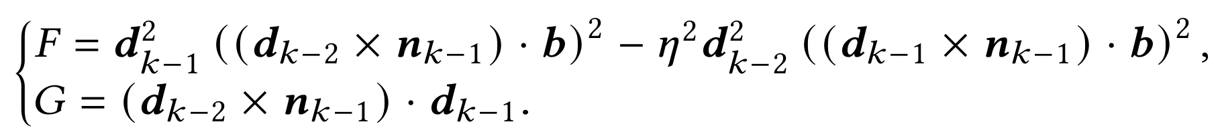
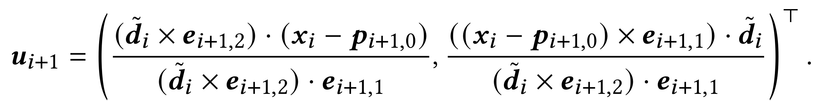
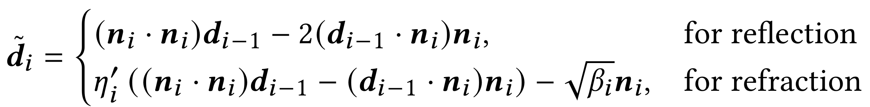
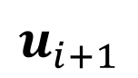
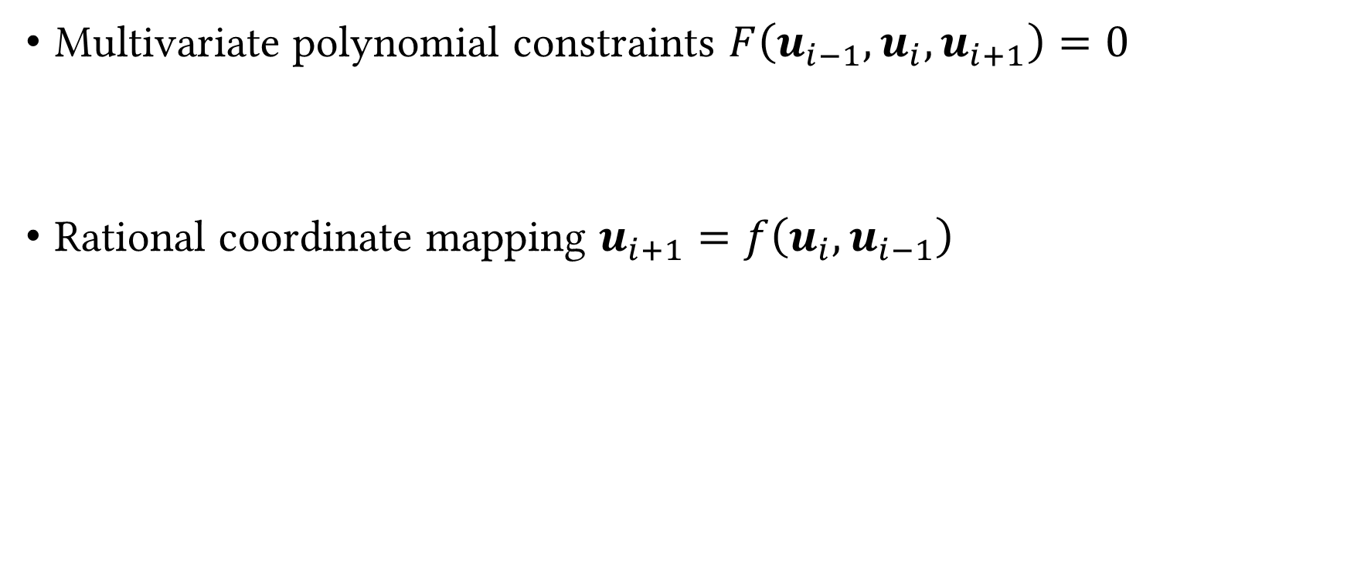
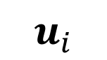
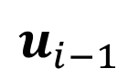
Specular Polynomials
Multivariate polynomial constraints $F\left(u_{i−1},u_{i},u_{i+1}\right)=0$
Rational coordinate mapping $u_{i+1}=f\left(u_{i},u_{i−1}\right)$
$$u_{i+1}$$
$$u_{i}$$
$$u_{i−1}$$

Slide 19
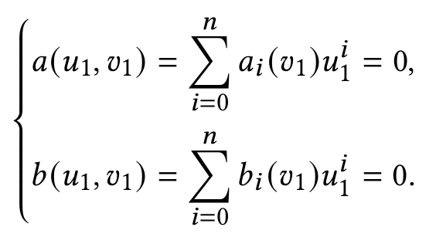
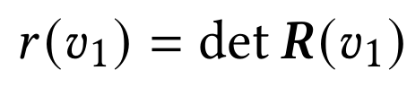
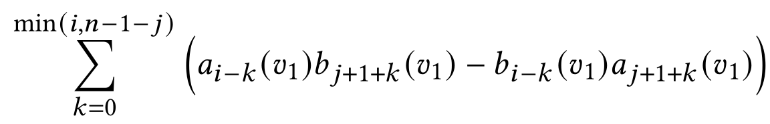

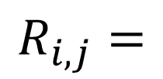
Resultant elimination for two polynomials
The necessary condition of
the existence of common roots of
two polynomials
Bézout’s resultant
$$R_{i,j}=$$
Only in $v_{1}$ now!
Notes:
We introduce the resultant,
the necessary condition of common roots of two polynomials.
This requires computes a matrix polynomial R and
then expand its determinant.

Slide 20


Deterministic search for specular paths
Select triangle tuples first (focus in Fan et al. 2025, also using SP)
Then find solutions using Newton’s method or polynomial solvers
[Walter et al. 2009] [Wang et al. 2020]
[Fan et al. 2024]
?
$$S$$
Configurations
Candidate set
Solutions

Slide 21
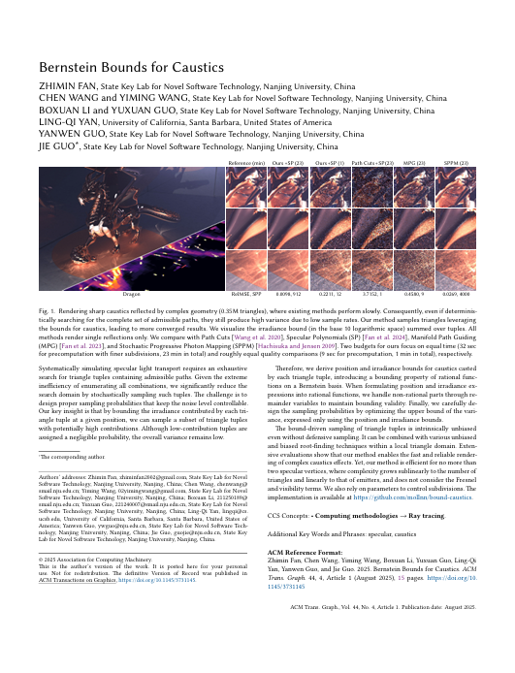
Bounding
Analytic Modeling

Slide 22
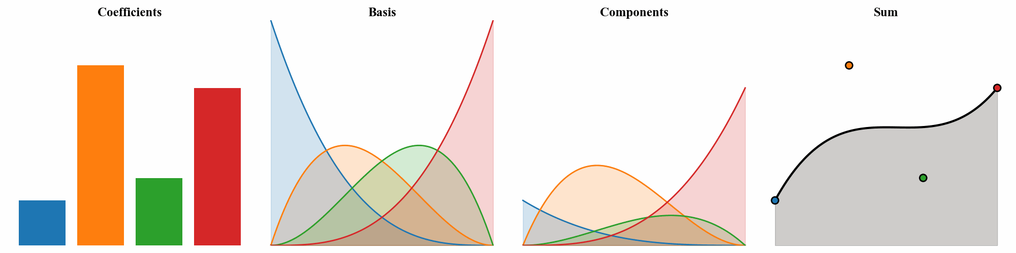
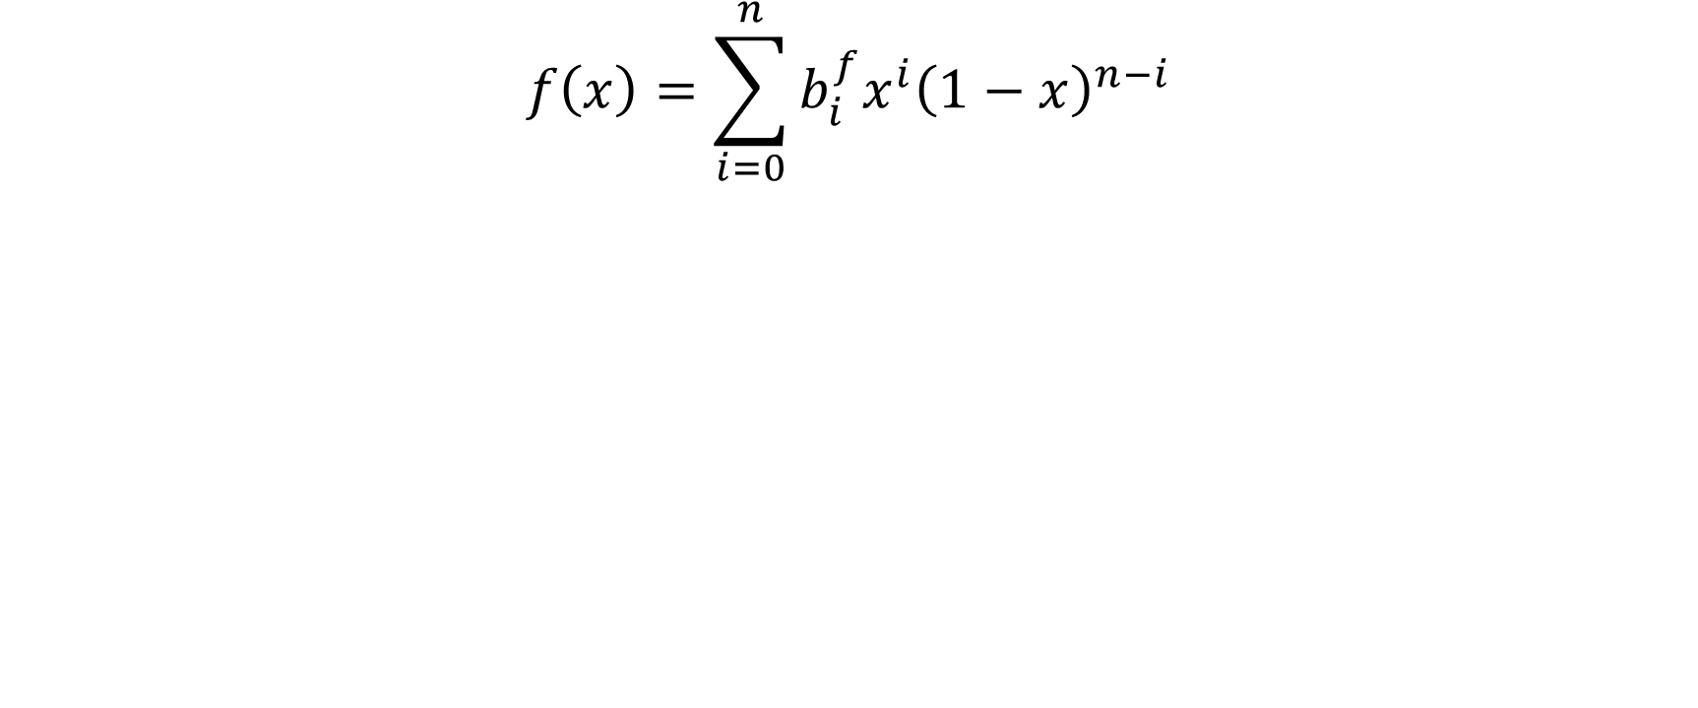
Bernstein polynomial basis
$$f\left(x\right)=\sum_{i=0}^{n}{b_{i}^{f}x^{i}{\left(1−x\right)}^{n−i}}$$

Slide 23
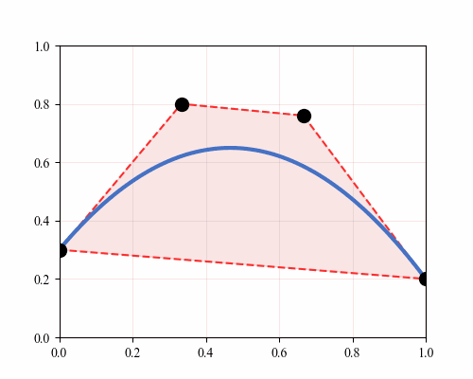
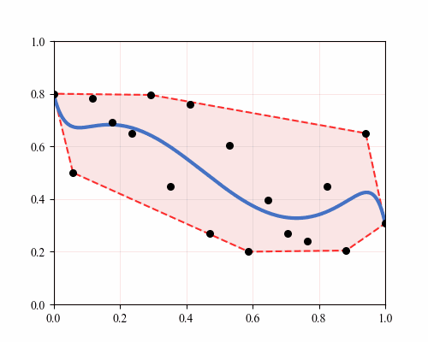
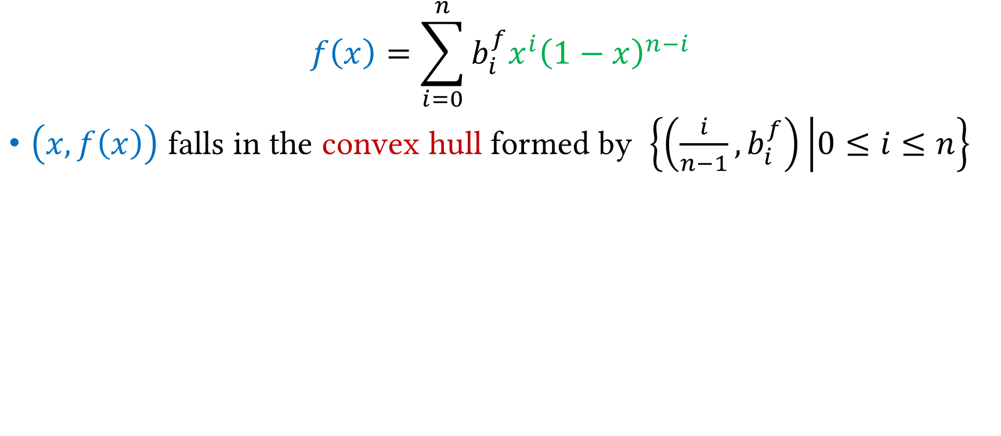
Bounding the range of polynomials
$$f\left(x\right)=\sum_{i=0}^{n}{b_{i}^{f}x^{i}{\left(1−x\right)}^{n−i}}$$
$\left(x,f\left(x\right)\right)$ falls in the convex hull formed by $\left\{\left(\frac{i}{n−1}, b_{i}^{f}\right) | 0≤i≤n\right\}$

Slide 24
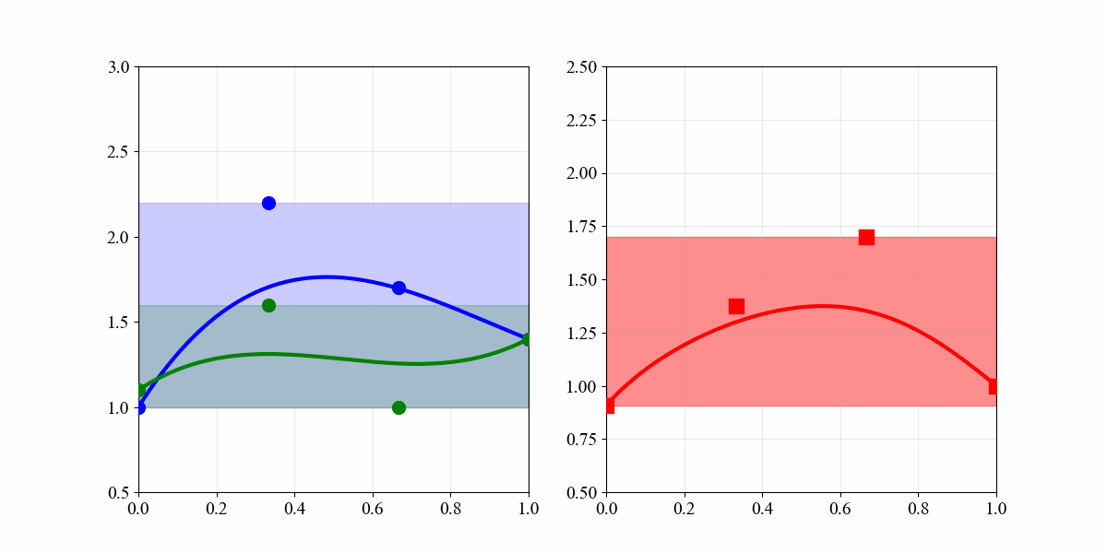
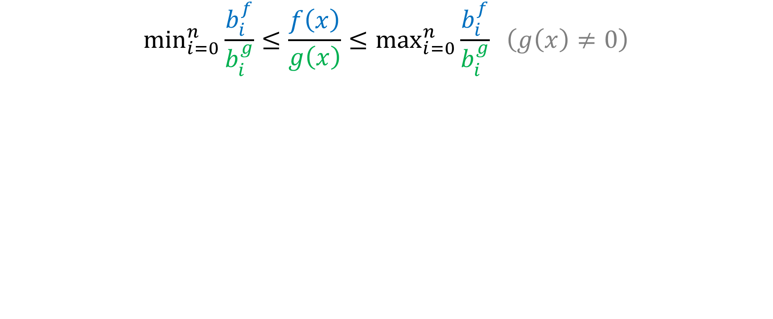
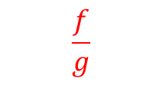
Bounding the range of rational functions
$$\min_{i=0}^{n}{\frac{b_{i}^{f}}{b_{i}^{g}}}≤\frac{f\left(x\right)}{g\left(x\right)}≤\max_{i=0}^{n}{\frac{b_{i}^{f}}{b_{i}^{g}}} \left(g\left(x\right)≠0\right)$$
[Narkawicz et al. 2012]
$$\frac{f}{g}$$

Slide 25
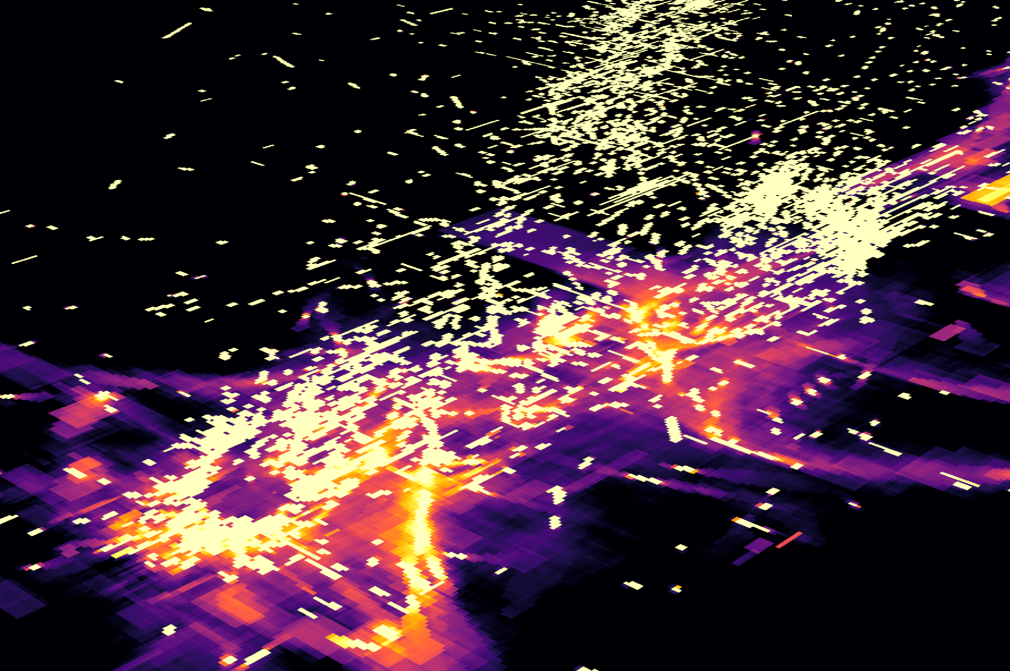
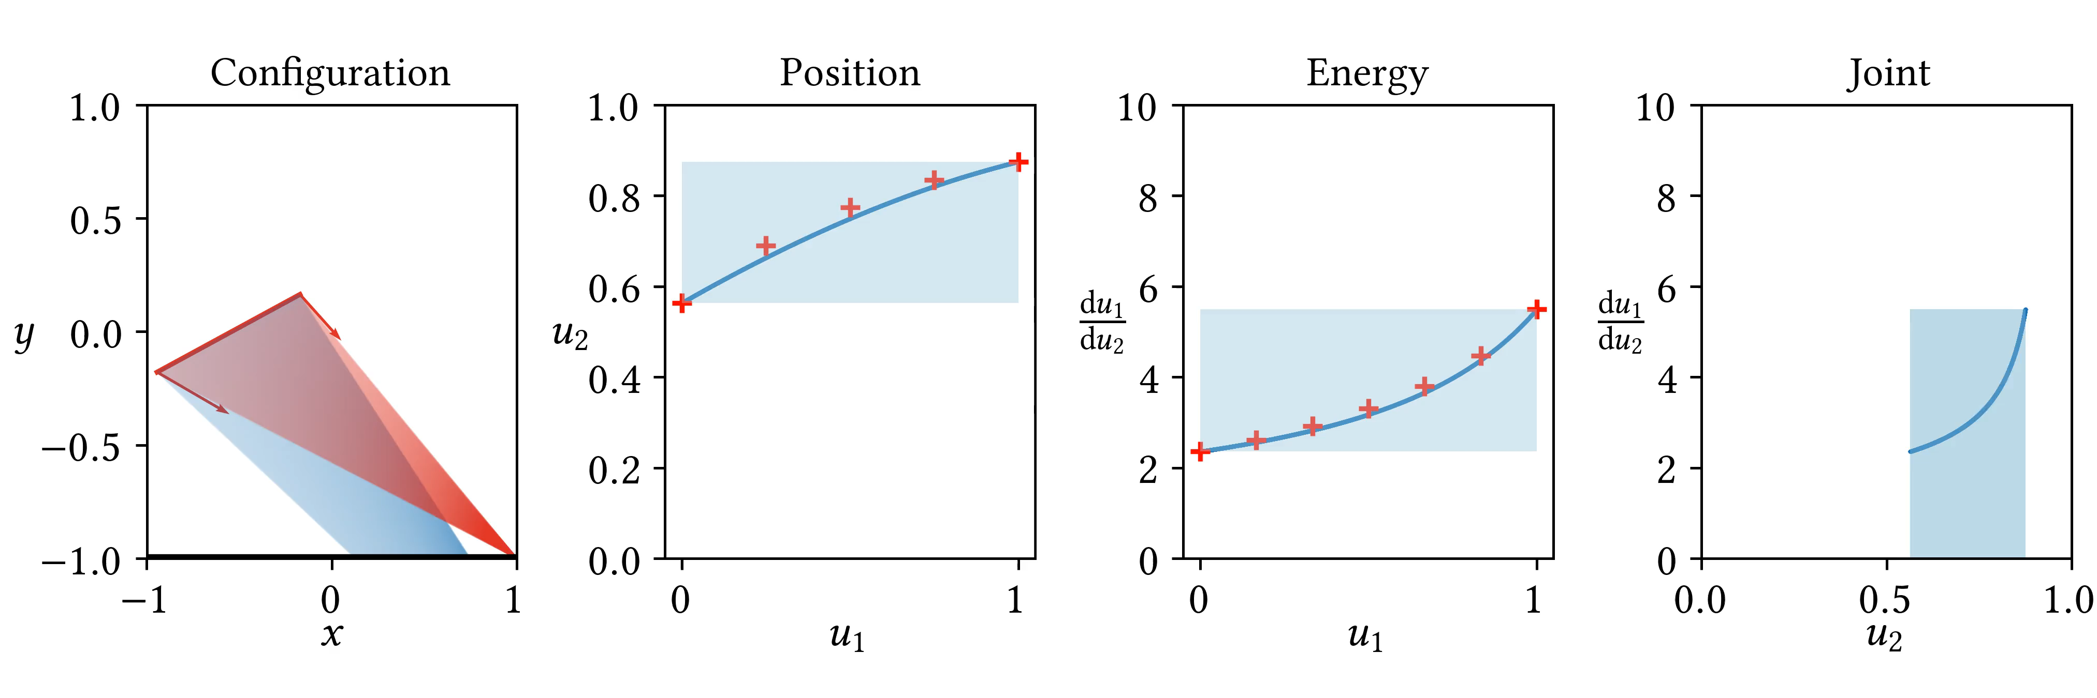
Bernstein bounds for caustics
Represent caustics with Bernstein polynomials
Obtain their bounds using the bounding property

Slide 26
Summary
Fitting distributions for the constrain solutions (23’)
General
Needs training/initial distributions, suffers from outlier cases, so…
Reformulating constraints into polynomials (24’)
Thus enabling many mathematical tools
Solving (24’)
Resultant elimination | Root isolation/QZ decomposition
Too slow due to enumeration, so…
Bounding (25’)
Bernstein polynomials | Regression with remainders
Producing an approximated distribution of the constrain solutions

Slide 27
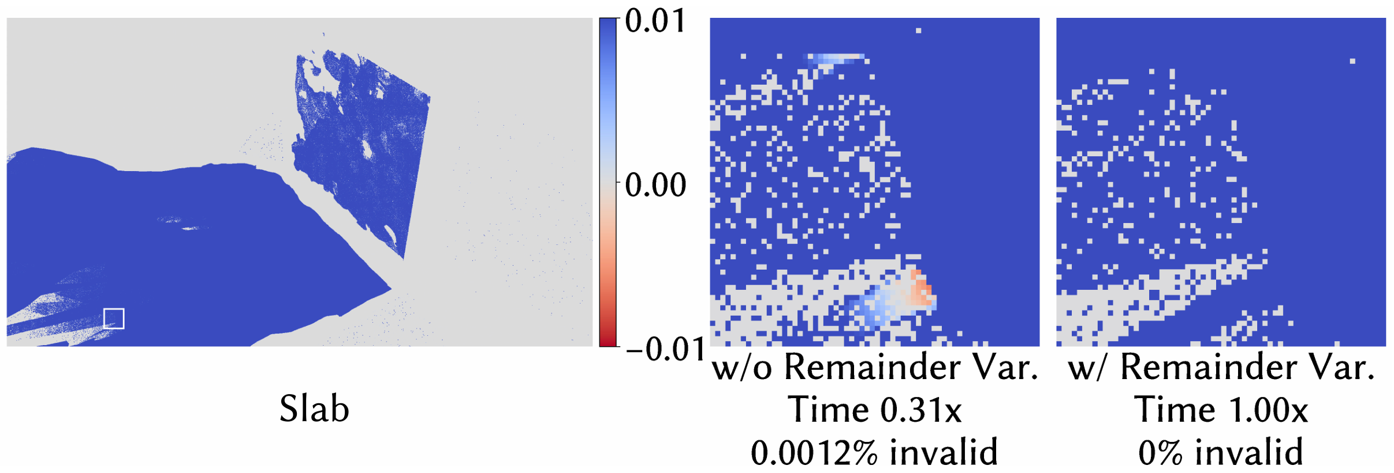
Open questions
Performance
We focus on
a theoretically sound solution
and accurate modeling
Allow violations/approximations to be more efficient
How to strike a balance?

Slide 28
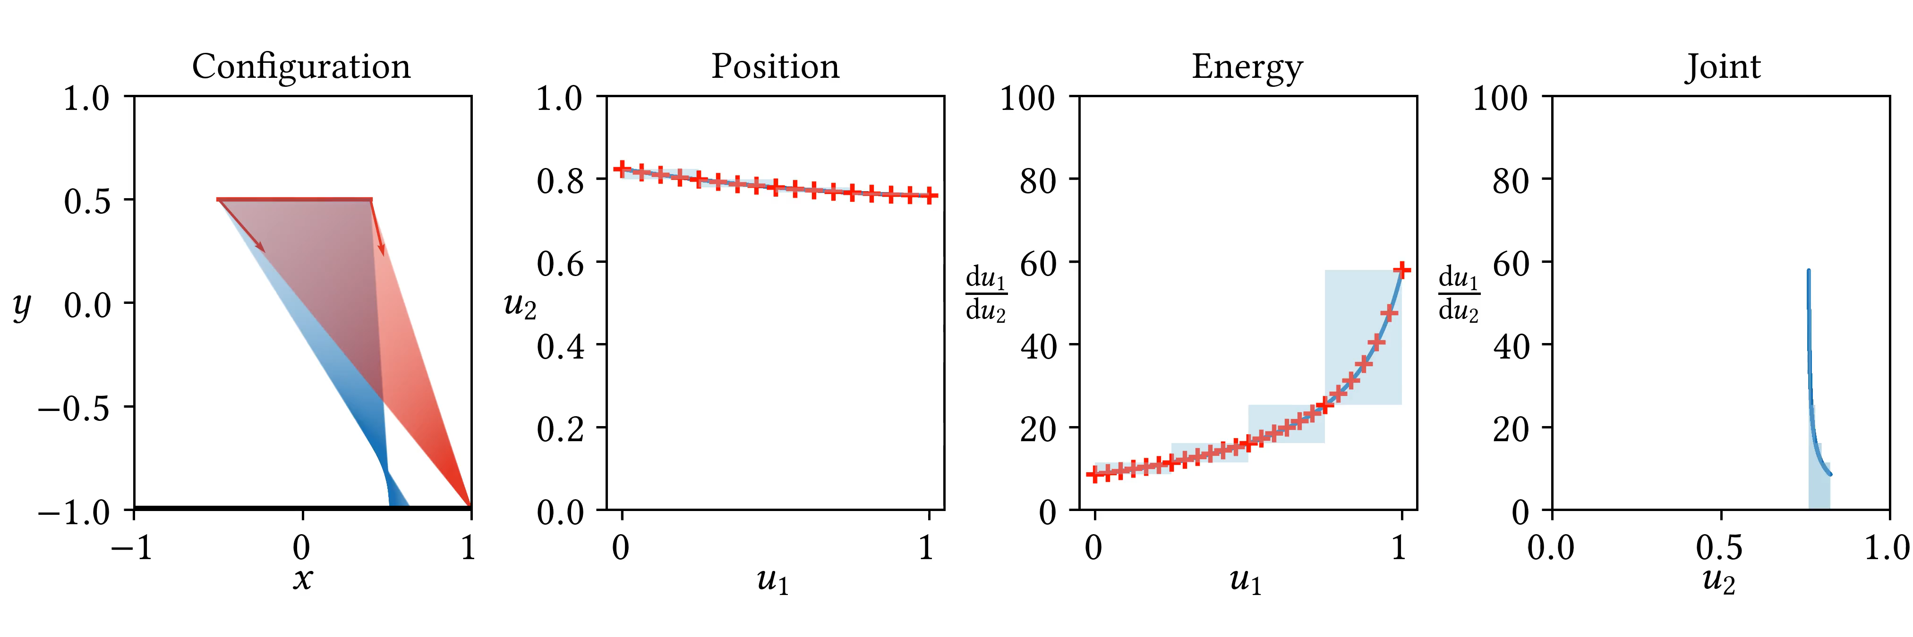
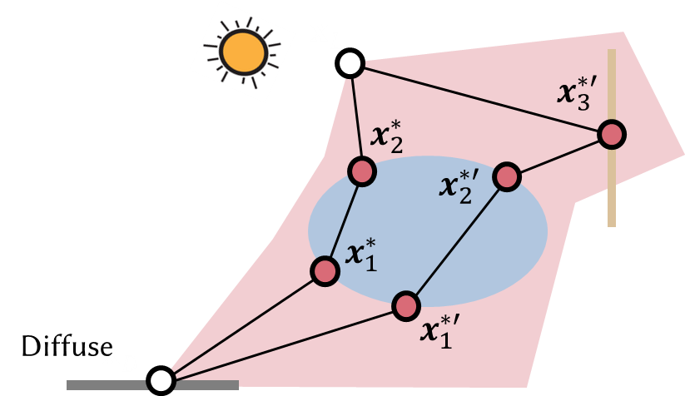
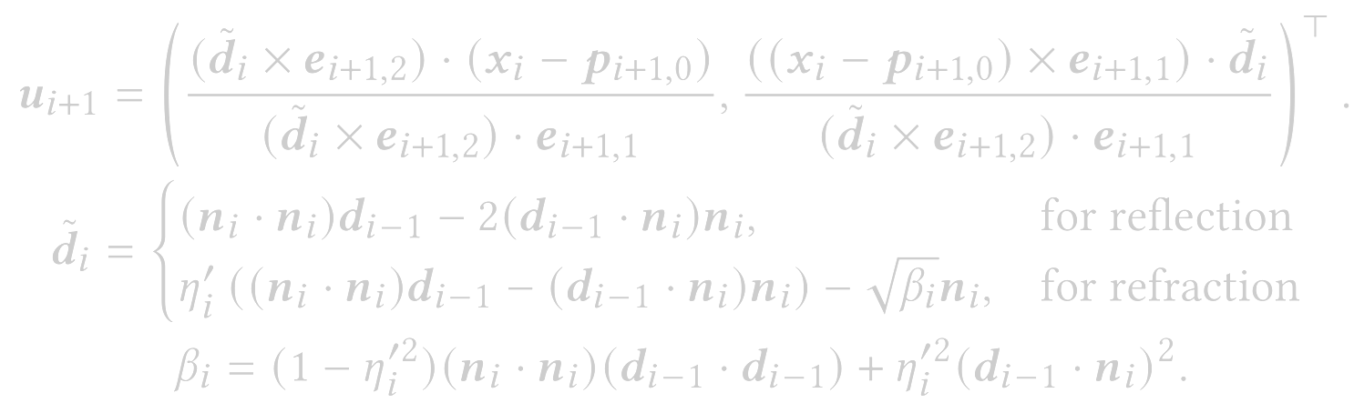
Thank You!
Homepage
zhiminfan2002@gmail.com
Contact me if you have any questions!

